Slide 1

Shodan IN Ottawa
Sunny Jamwal

Slide 2

Agenda
Introduction
Shodan
Overall Stats
Common Ports
Top Employers
Recommendations
Q&A
Notes:
GRANT

Slide 3
whoami
Sunny Jamwal
Cybersecurity Consultant at GoSecure Inc.
Noob Malware Researcher
PowerShell Preacher
Red and Blue Team Tinker
Twitter: @browninfosecguy
Notes:
Grant

Slide 4

Shodan
Shodan is a search engine for everything and anything on the internet.
It crawls the internet to find devices and potential vulnerabilities
Helps defenders see what is exposed online so they can fix and increase their security posture
Helps attackers see potential entry points during a red team/pentest engagement
Notes:
Grant

Slide 5
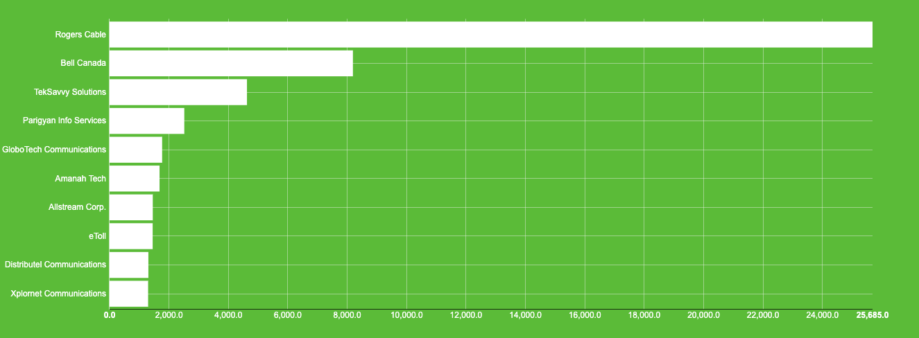
Shodan
Notes:
Grant

Slide 6
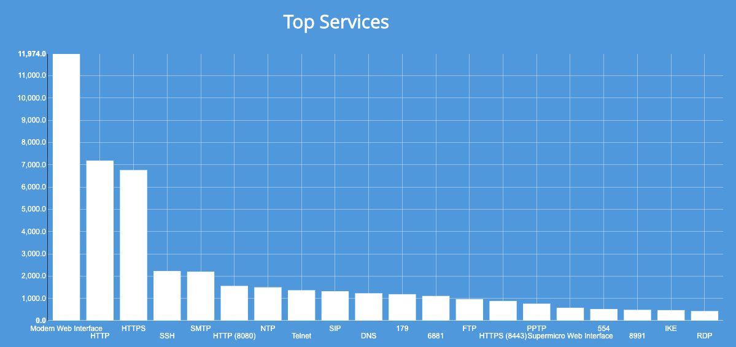
Shodan
Notes:
Grant

Slide 7
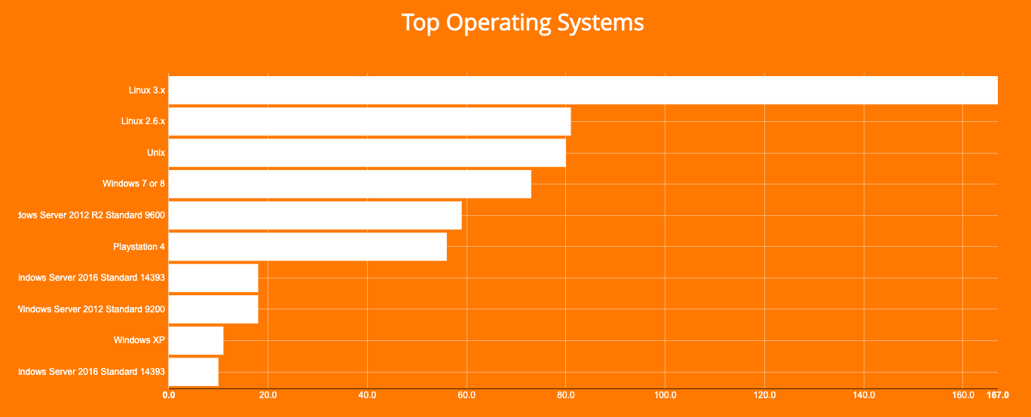
Shodan
Notes:
Grant

Slide 8
FTP - PORT 21
Notes:
Sunny

Slide 9
FTP - PORT 21
Notes:
Sunny

Slide 10
Telnet - Port 23
Notes:
Sunny

Slide 11
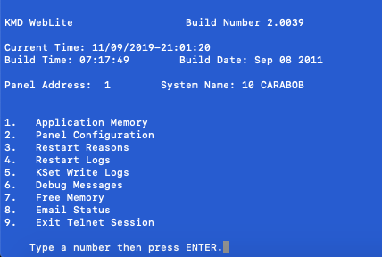
Telnet - Port 23
Notes:
Sunny

Slide 12
SSH – Port 22
Notes:
Sunny

Slide 13
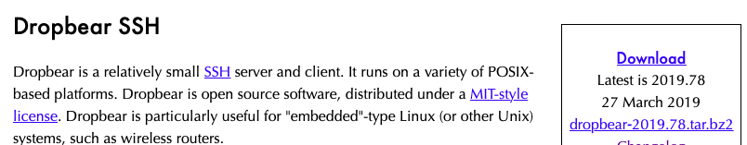

SSH – Port 22
Only 1 (one) server out of 184 was running the latest version of Dropbear SSHD
Only 1 (one) server out of 623 was running the latest version of OpenSSH
Notes:
Sunny

Slide 14
SMB – Port 445
Notes:
Sunny

Slide 15

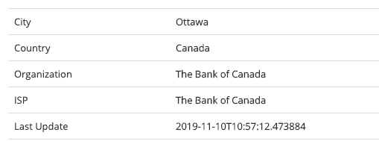
LDAP – Port 389 (clear text)
Total 53 Results
Notes:
Sunny

Slide 16
RDP - port 3389
Notes:
Grant

Slide 17
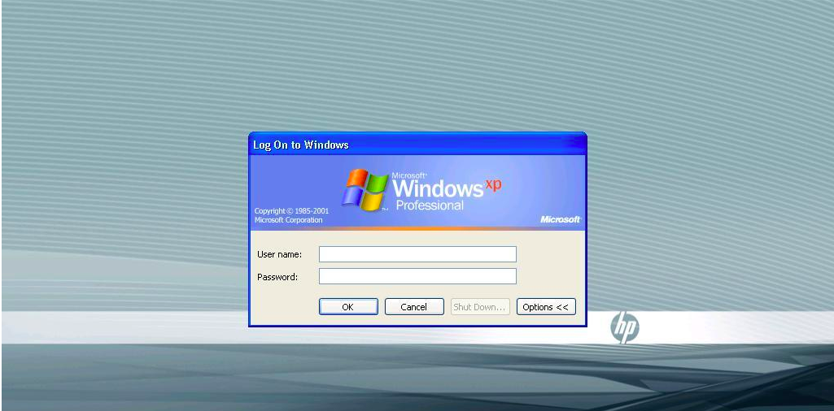
RDP - port 3389
Notes:
Grant

Slide 18
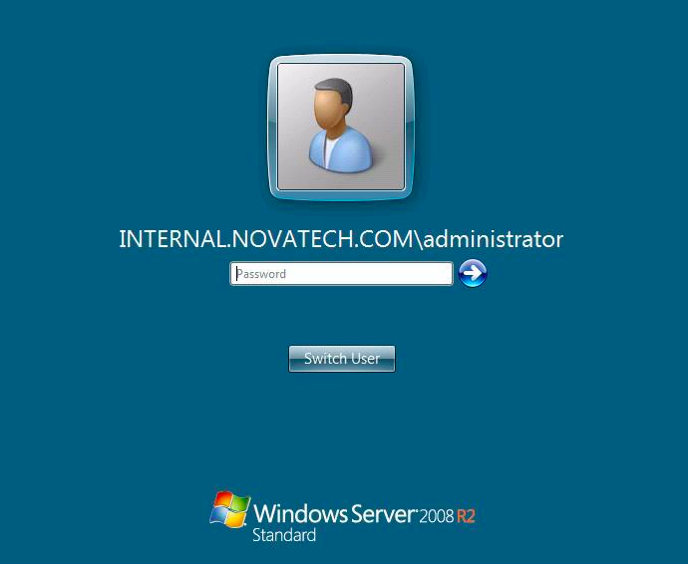
RDP - port 3389
Notes:
Grant

Slide 19
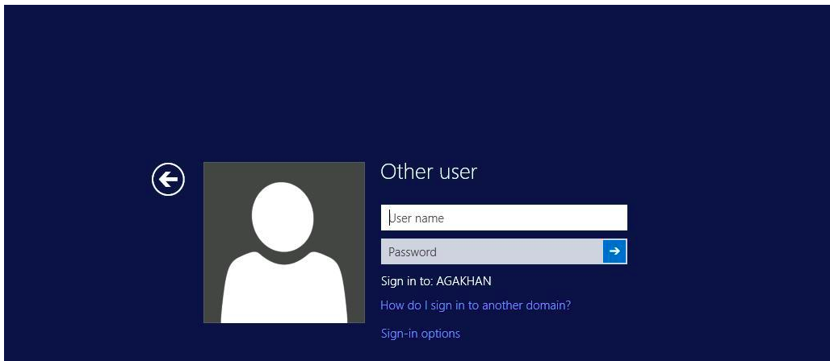
RDP - port 3389
Notes:
Grant

Slide 20
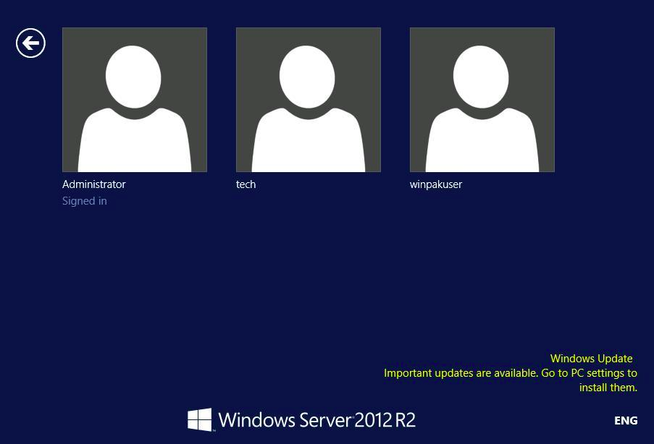
RDP - port 3389
Notes:
Grant

Slide 21
SMTP - port 25
Notes:
sunny

Slide 22
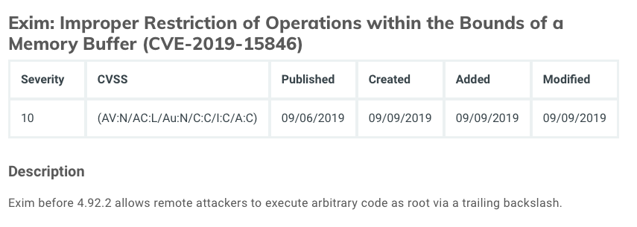
SMTP – Port 25
Notes:
sunny

Slide 23

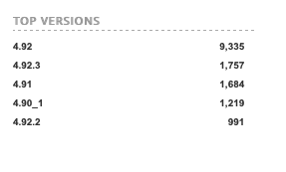
SMTP – Port 25
Notes:
sunny

Slide 24

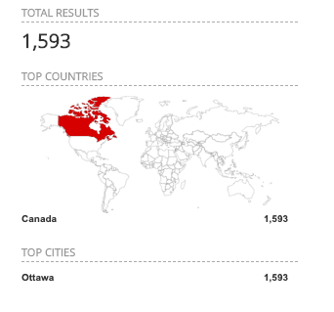
PORT 8080
Notes:
sunny

Slide 25
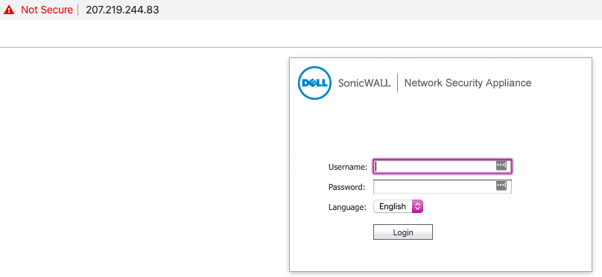
PORT 8080
Notes:
sunny

Slide 26
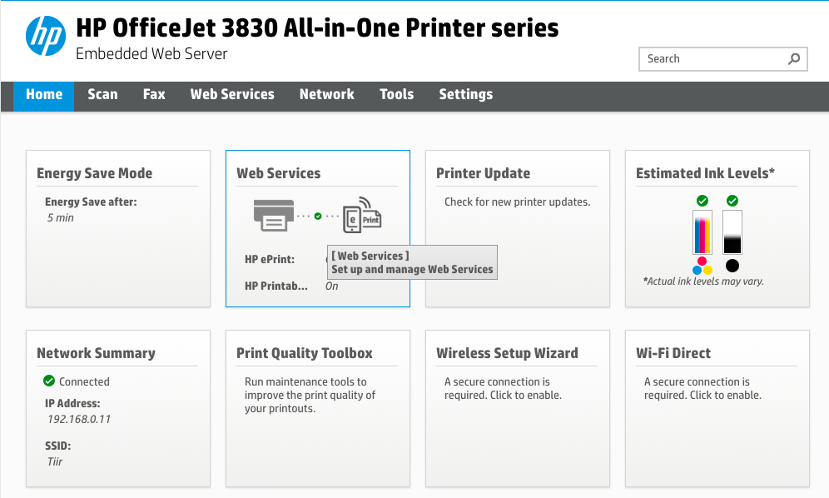
PORT 8080
Notes:
sunny

Slide 27
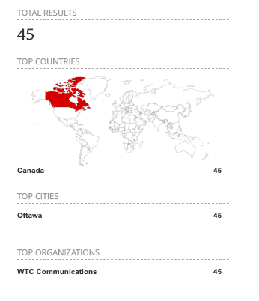
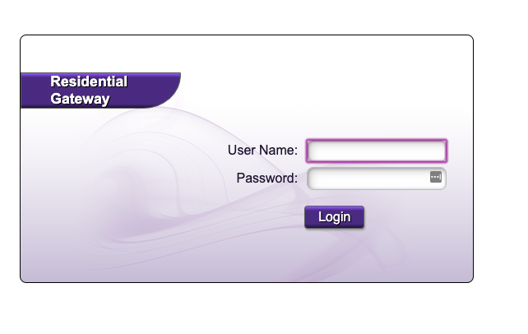
PORT 8080
Notes:
sunny

Slide 28

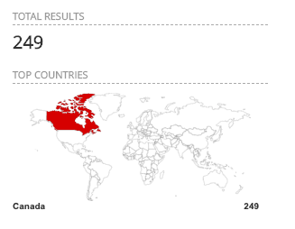
PORT 3306 - MySQL
Notes:
sunny

Slide 29

Shodan
Notes:
sunny

Slide 30


Shodan
Notes:
sunny

Slide 31

Notes:
sunny

Slide 32


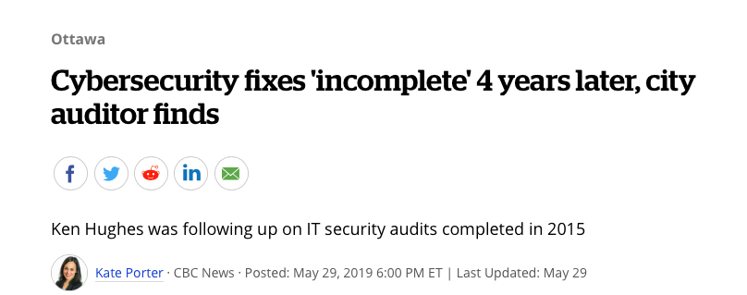
City of Ottawa
Notes:
sunny

Slide 33
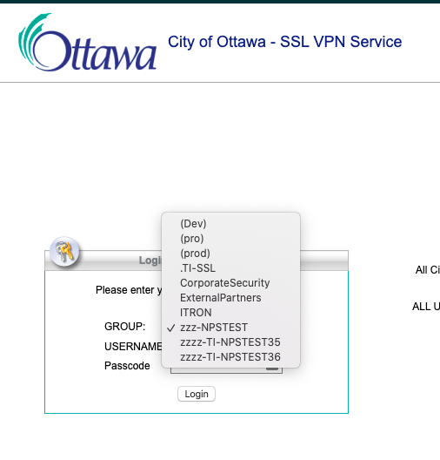
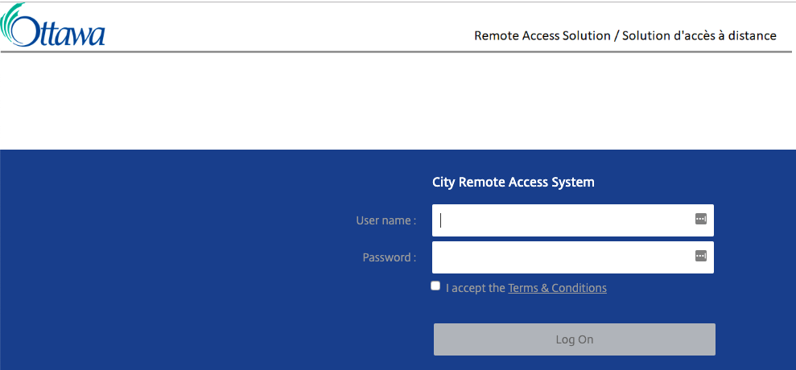
City of Ottawa
Notes:
sunny

Slide 34
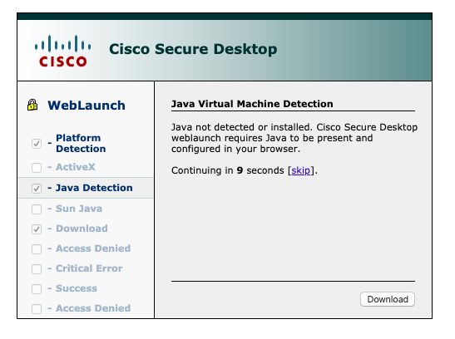
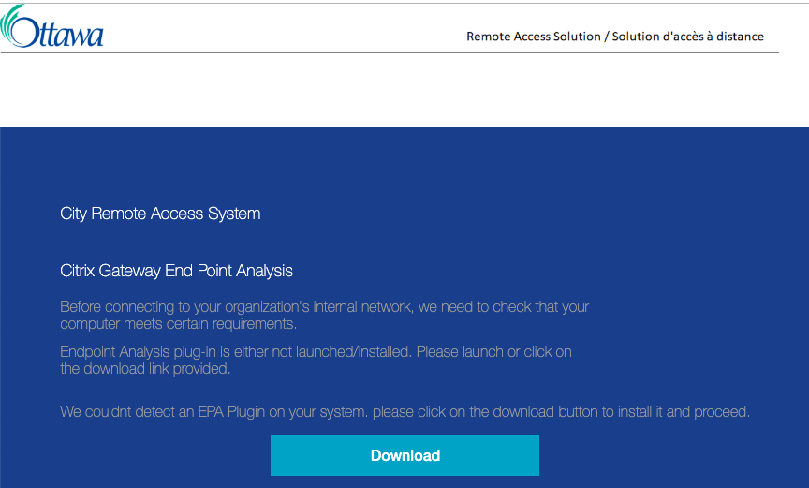
City of Ottawa
Notes:
sunny

Slide 35
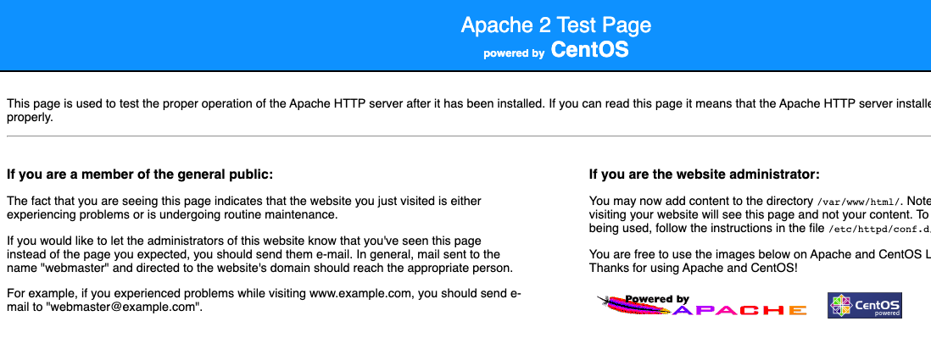
City of Ottawa
Notes:
sunny

Slide 36
Notes:
sunny

Slide 37

Shared Services Canada
“Shared Services Canada (SSC) delivers digital services to Government of Canada organizations. We provide modern, secure and reliable IT services so federal organizations can deliver digital programs and services that meet Canadians needs.”
Notes:
sunny

Slide 38
Shared Services Canada
Notes:
sunny

Slide 39
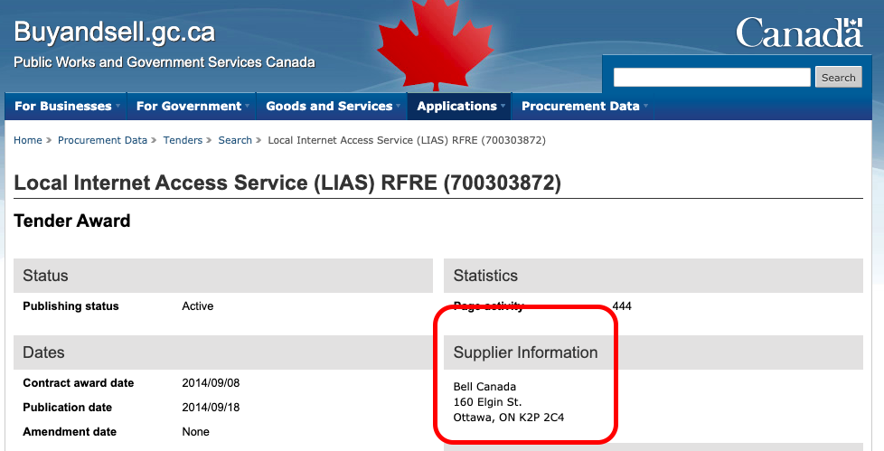
Shared Services Canada
Notes:
sunny

Slide 40
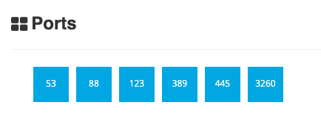
Shared Services Canada
Notes:
sunny

Slide 41
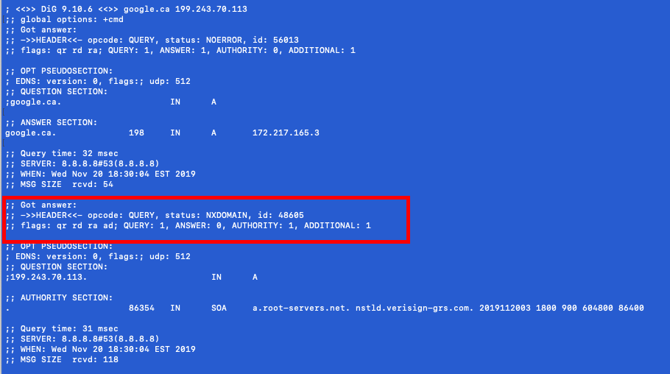
Shared Services Canada – (DNS Recursion enabled)
Notes:
sunny

Slide 42
Shared Services Canada
Notes:
sunny

Slide 43

Shared Services Canada
Notes:
sunny

Slide 44
Shared Services Canada
Notes:
sunny

Slide 45
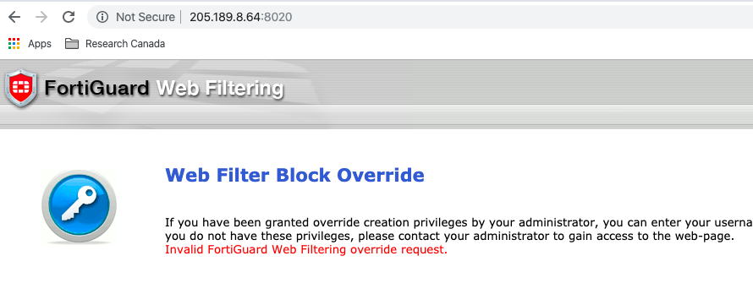
Shared Services Canada
Notes:
sunny

Slide 46
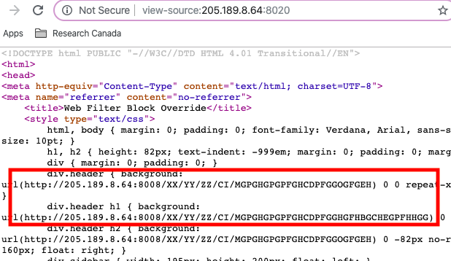
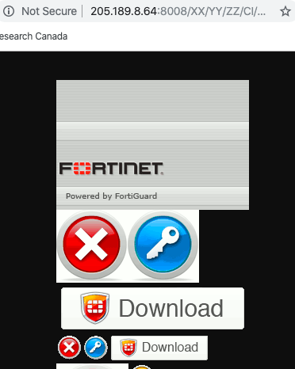
Shared Services Canada
Notes:
sunny

Slide 47
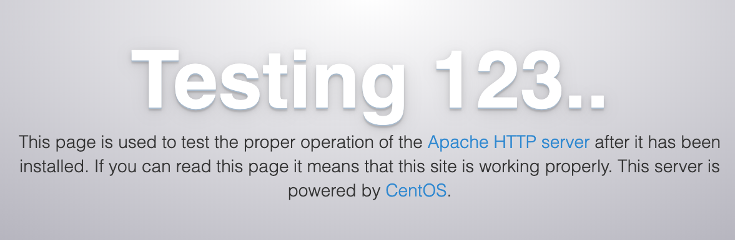
********* University *******
Notes:
grant

Slide 48

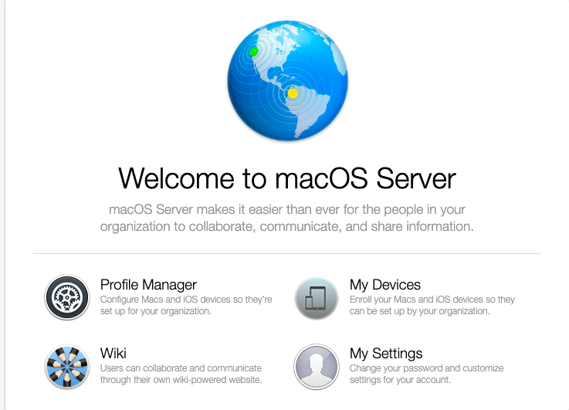
University
Notes:
grant

Slide 49
Recommendations
ASSET INVENTORY
TRACK YOUR DATA
TRACK SHADOW IT
STUDY YOUR ADVERSARY
INVEST IN AN EDR SOLUTION
AT MINIMUM IMPLEMENT CIS CONTROLS

Slide 50

QUESTIONS!!!

